Slide 1
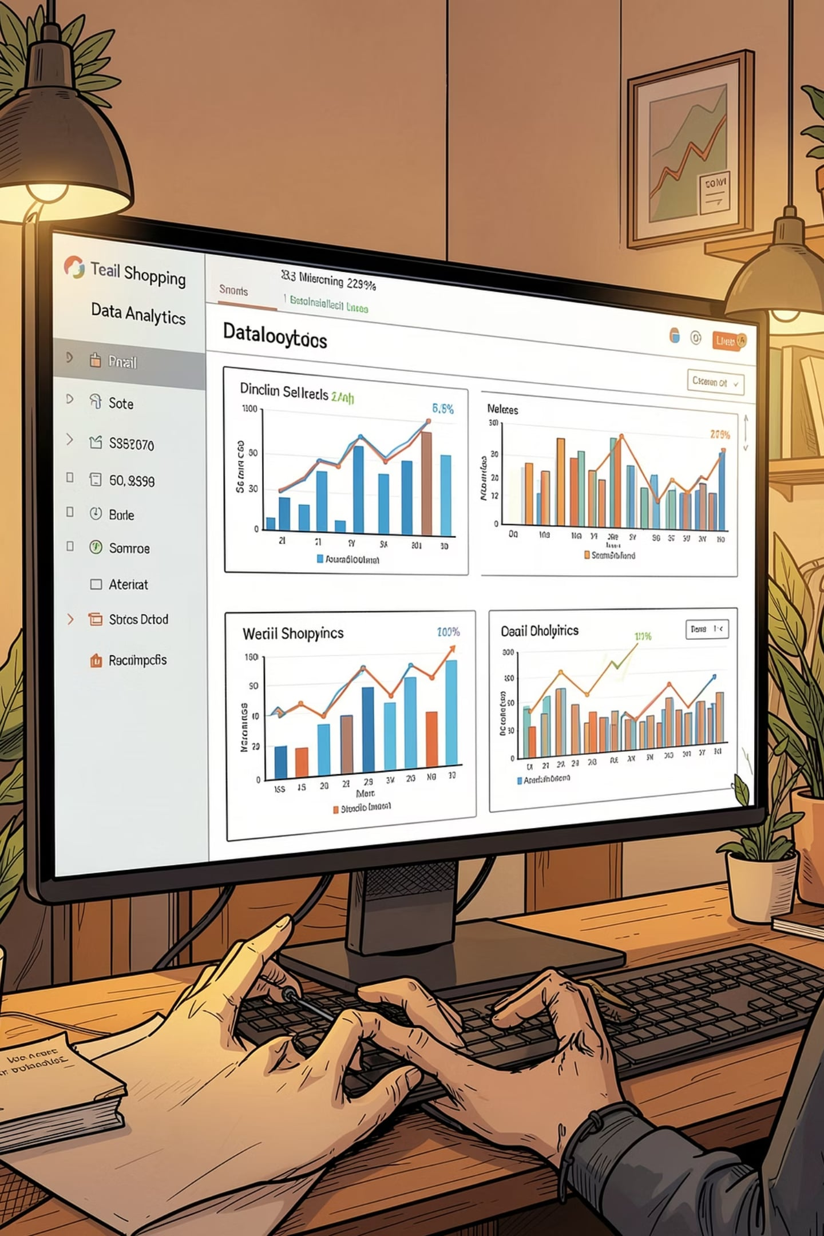
Customer Shopping Details Analysis
Python · SQL · Power BI — Analyzing 6,000 customer transactions to uncover purchasing patterns, preferences, and business opportunities.

Slide 2

Project Overview
This project analyzes 6,000 customer transactions across 18 attributes to identify purchasing patterns, customer preferences, sales trends, subscription behavior, seasonal demand, and payment preferences. The goal is to surface actionable business opportunities for stakeholders.
MySQL
Power BI
Python
Data storage & SQL analysis
Interactive dashboards
Data preparation & cleaning

Slide 3




Dataset Summary
6,000 records across 18 columns capturing customer demographics, purchase behavior, and transaction details.
Customer Profile
Purchase Details
Customer ID, Age, Gender, Location
Item, Category, Amount (Rs.), Size, Color, Season
Engagement
Transaction
Review Rating, Subscription Status, Previous Purchases, Frequency
Shipping Type, Discount Applied, Promo Code, Payment Method

Slide 4
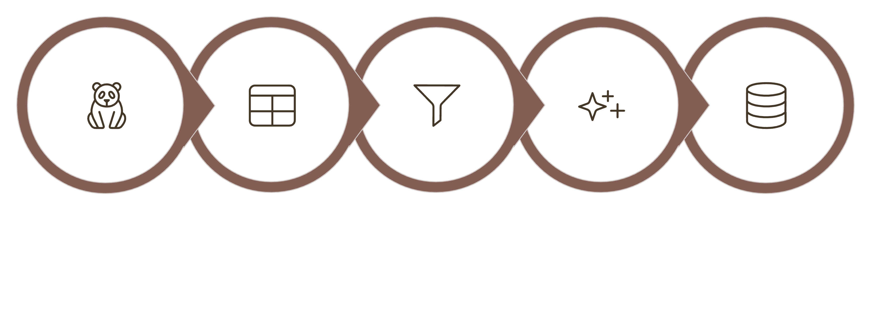
Exploratory Data Analysis — Python
Initial Exploration
Handle Missing
Feature Engineering
Load Data
DB Integration
Key steps included renaming columns to snake_case, imputing missing Review Ratings using category medians, creating age_group and purchase_frequency_days features, and dropping the redundant promo_code_used column before loading the cleaned DataFrame into PostgreSQL.

Slide 5
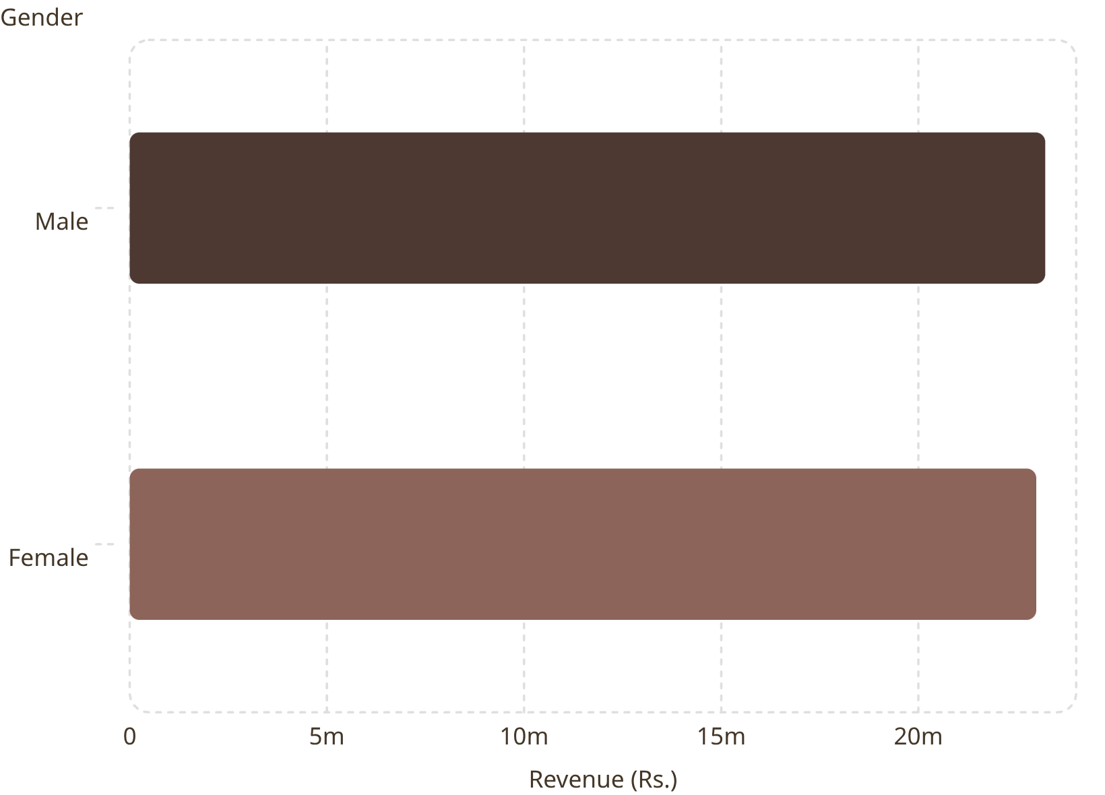
Revenue & Spending Insights — SQL
Key Findings
Male and female revenue is nearly equal — ₹23.2M vs ₹22.9M
Several customers using discounts still spent above the average purchase amount (e.g., customer 100006 spent ₹14,965)
Standard shipping avg: ₹7,713 vs Express: ₹7,633
Subscribed customers spend slightly less on average (₹7,625 vs ₹7,771)

Slide 6
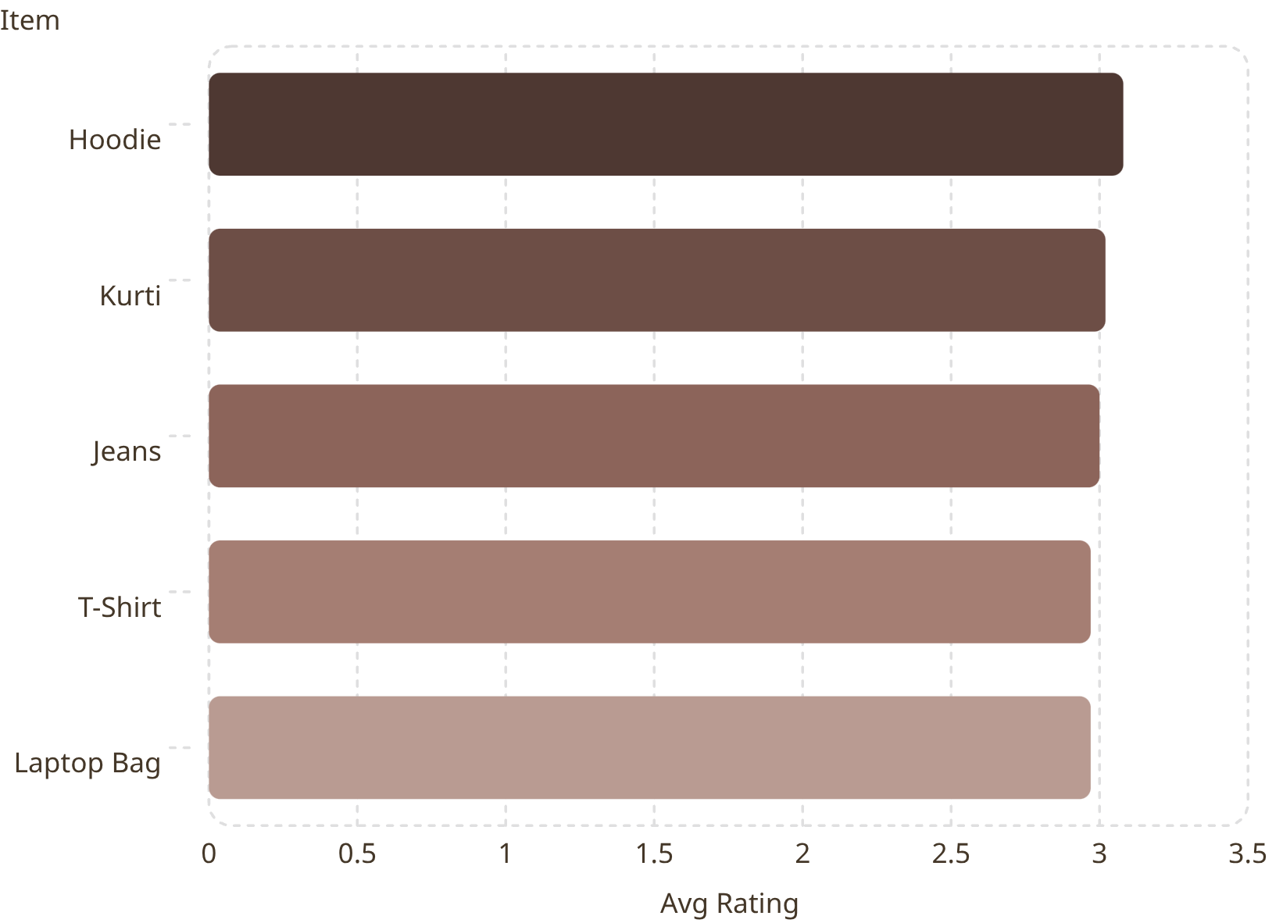
Top Products & Ratings
Most Discounted Products
Item
Discount Rate
Watch
51.98%
Sneakers
51.54%
Jeans
49.78%
Laptop Bag
49.58%
Kurti
49.48%
Top 3 products per category: Jeans, T-Shirt, Kurti (Clothing); Watch, Laptop Bag (Accessories); Sneakers (Footwear).

Slide 7
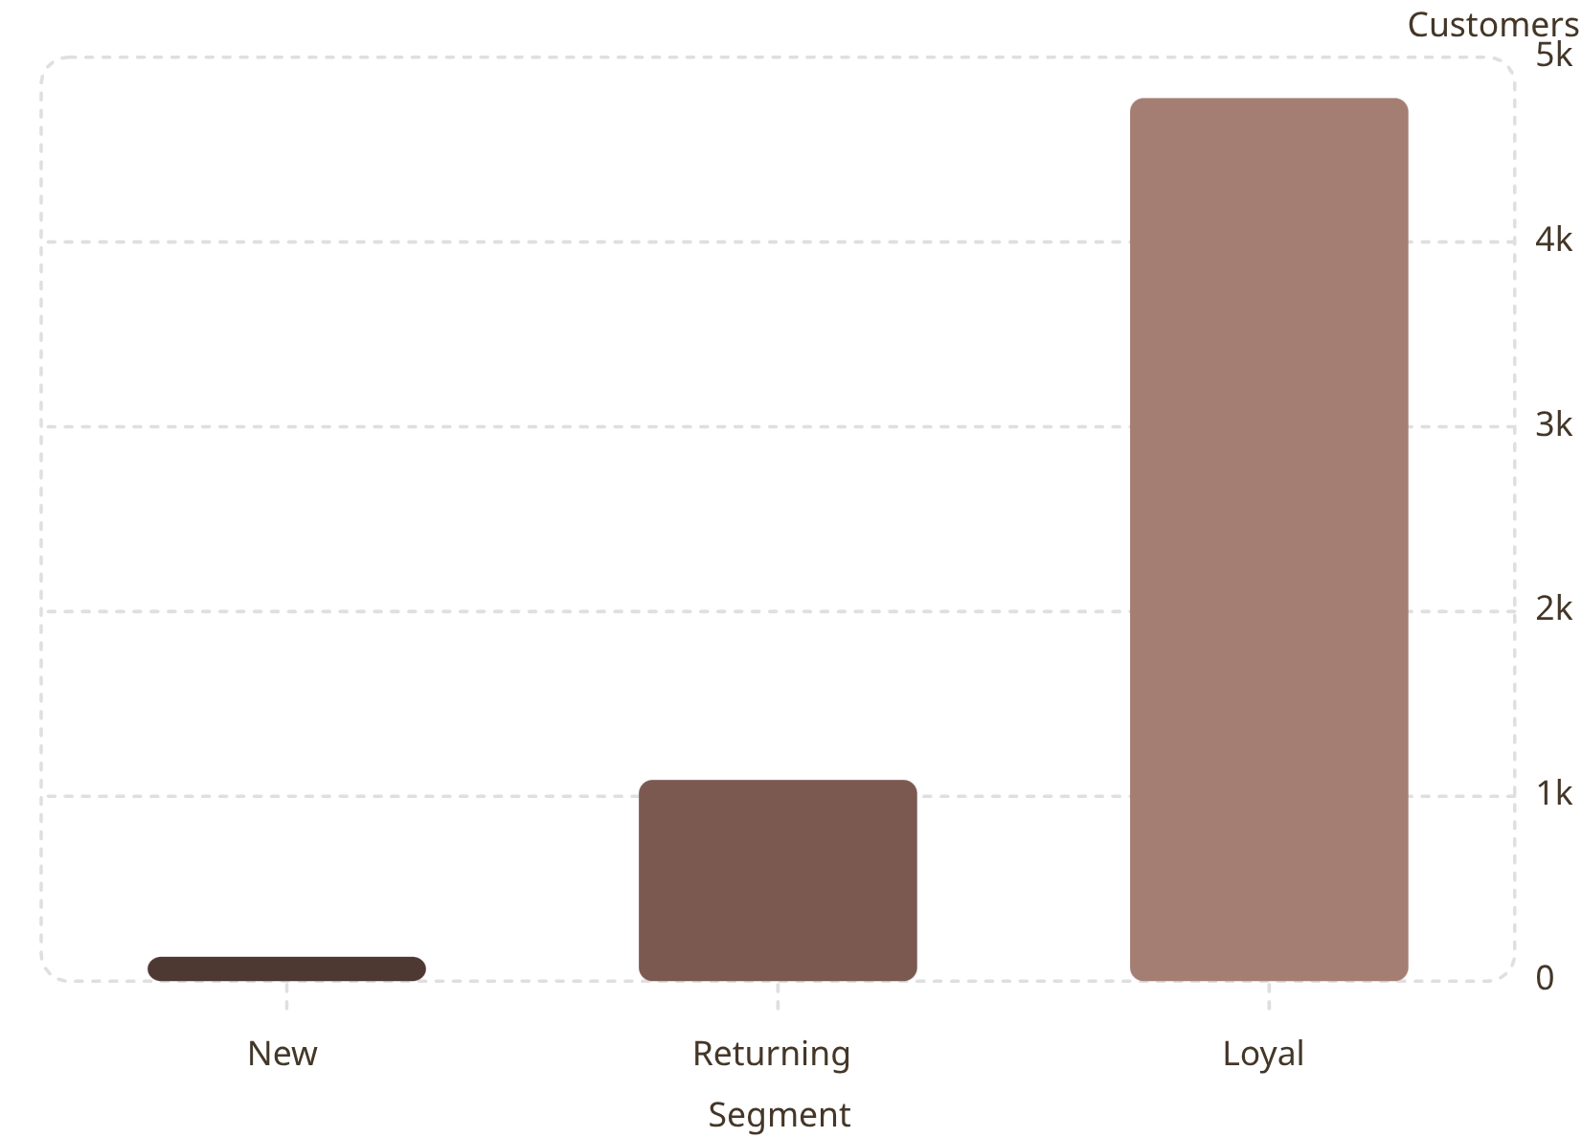


Customer Segmentation
Segment Definitions
Loyal — 4,779
Customers with 5+ previous purchases
Returning — 1,089
Repeat buyers building purchase history
New — 132
First-time or low-frequency shoppers
Repeat buyers (5+ purchases) show nearly equal subscription rates: 2,613 subscribed vs 2,764 not subscribed.

Slide 8
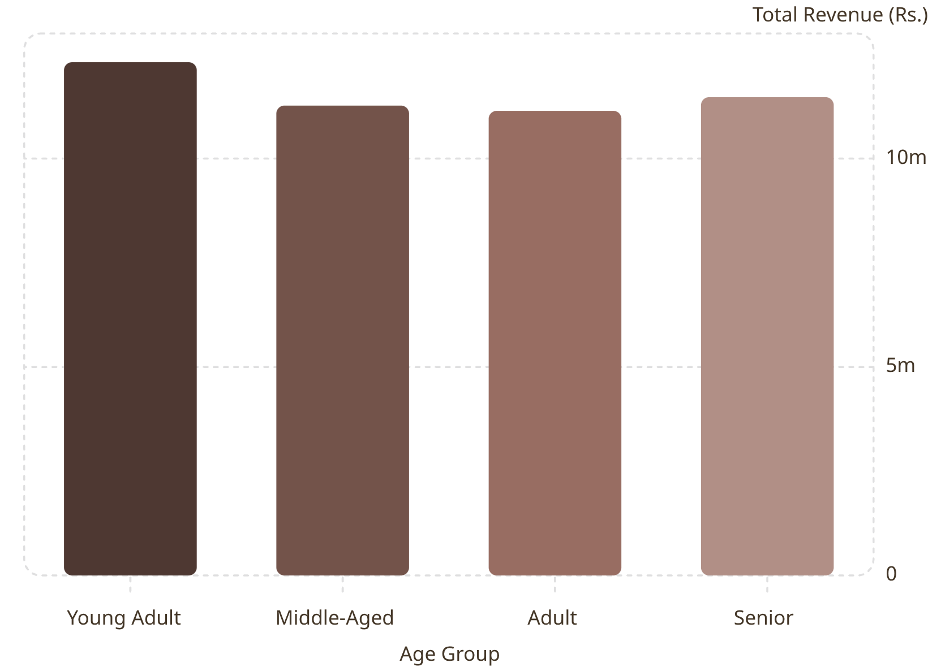
Revenue by Age Group
Key Insight
Young adults generate the highest total revenue at ₹12.3M, making them the most valuable age segment. Revenue is otherwise evenly distributed across middle-aged (₹11.3M), adult (₹11.1M), and senior (₹11.5M) groups — suggesting broad cross-generational appeal with a slight edge toward younger shoppers.

Slide 9
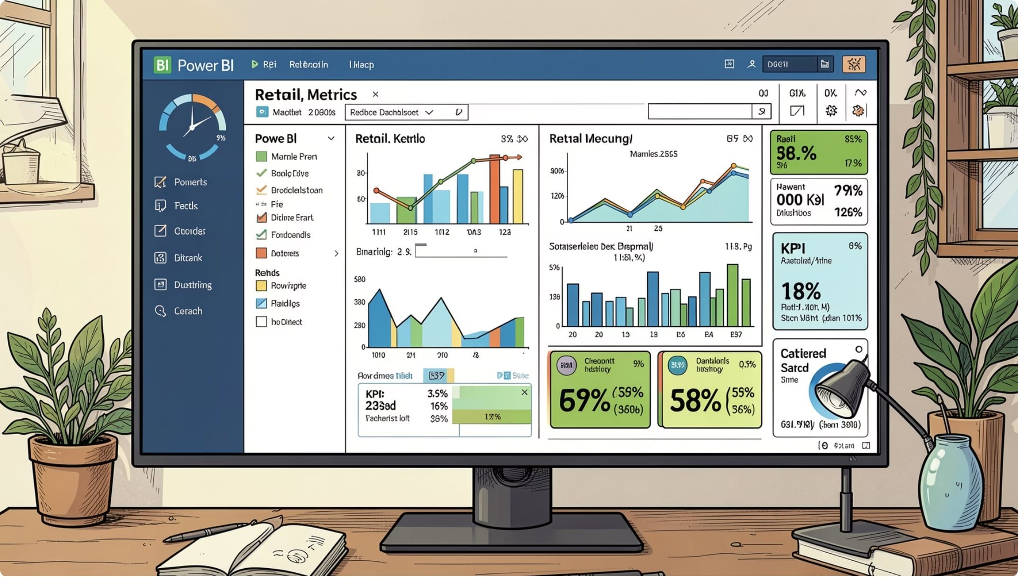
Power BI Dashboard
Dashboard Highlights
48.84% subscribed · 51.16% not subscribed
Clothing leads in both revenue (~₹1,000) and sales (~1.0K units)
Filters: Gender, Category, Subscription Status, Shipping Type
1.94K
₹7.63K
3.00
Total customers
Avg purchase amount
Avg review rating

Slide 10

Business Recommendations
Boost Subscriptions
Promote exclusive subscriber benefits to convert non-subscribers.
Loyalty Programs
Reward repeat buyers to accelerate movement into the "Loyal" segment.
Review Discount Policy
Balance sales lift from discounts against margin impact.
Product Positioning
Highlight top-rated and best-selling items (Hoodie, Jeans, Sneakers) in campaigns.
Targeted Marketing
Focus on high-revenue age groups — especially young adults — and express-shipping users.

